Slide 1

Control and Monitoring
Steel Plant Blast Furnace utilizing
FlowJams and DensFlow Devices
Vishakhapatnam Steel Plant (VSP)
Andhra Pradesh ( Southern India)
GTS, Inc.
PO Box 799,
Shalimar, FL 32579 USA
Phone: 850-651-3388
Fax: 850-651-4777
Email: info@onthelevel.com
Website: www.onthelevel.com
http://www.onthelevel.com/

Slide 2
Vishakhapatnam Steel Plant (VSP)
Andhra Pradesh ( Southern India)
http://www.onthelevel.com/
For a new Blast Furnace, VSP awarded the package to M/s Siemens VAI who in turn off loaded the PCI package to M/s Simplex Engineering.
The turnkey package was awarded to TCPL ( as per the below BOM) which included supervision for I&C.
FlowJam : 70 nos.
Densflow DN 100 with an evaluation unit : 02 sets
Fully wired Panel for FlowJam & DensFlow : 01 sets each
Junction Box with mounting sets for Flowjam : 68 nos.
4 – core armored cable : 14,000 meters
Process adapters and counter flanges : 68 & 4 nos. resp.

Slide 3
Vishakhapatnam Steel Plant (VSP)
Andhra Pradesh ( Southern India)
http://www.onthelevel.com/
At our factory the project team fabricated the process adapters for the FlowJams, control cabinets (completely wired), MCB, and Power supply.
Perfect coordination with TCPL (sales & service), Simplex, Siemens and VSP was done to ensure that the installation was completed. The system has been commissioned and the performance is satisfactory.
Service personal visited site to co-ordinate with VSP engineers, define the location, wiring cable route etc.

Slide 4
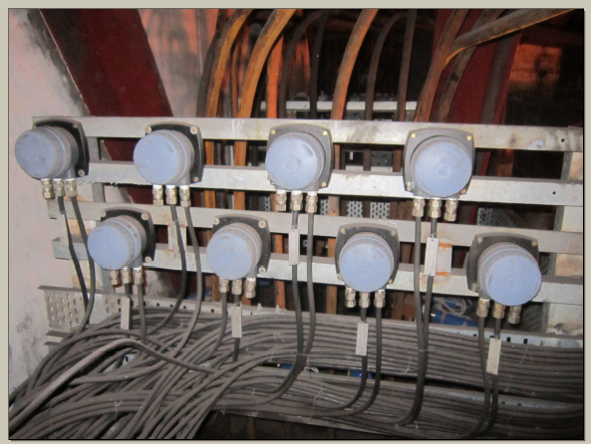
Vishakhapatnam Steel Plant (VSP)
Andhra Pradesh ( Southern India)
http://www.onthelevel.com/
Junction Boxes for FlowJam

Slide 5
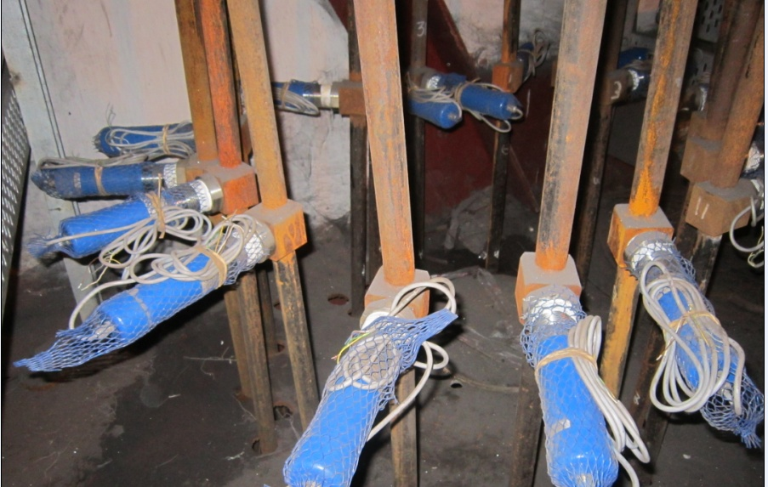
Vishakhapatnam Steel Plant (VSP)
Andhra Pradesh ( Southern India)
http://www.onthelevel.com/
FlowJams installed at each Lance of CDI of Blast Furnace

Slide 6
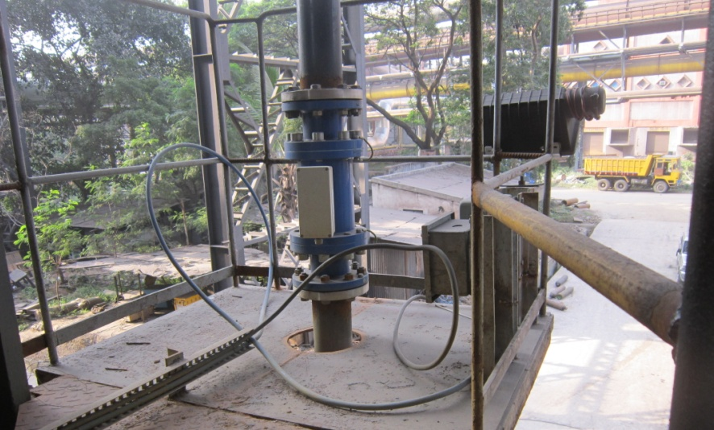
Vishakhapatnam Steel Plant (VSP)
Andhra Pradesh ( Southern India)
http://www.onthelevel.com/
DensFlow installed at the main feeding line of the Blast Furnace.

