Slide 1
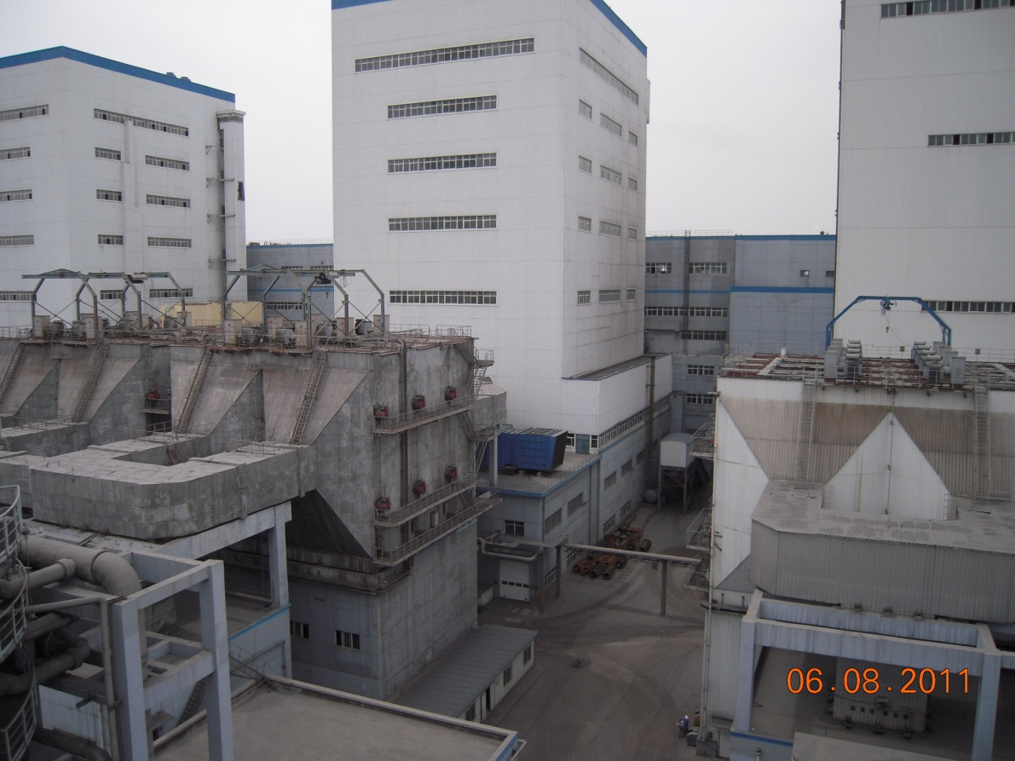
  ESP Hopper Management

Slide 2
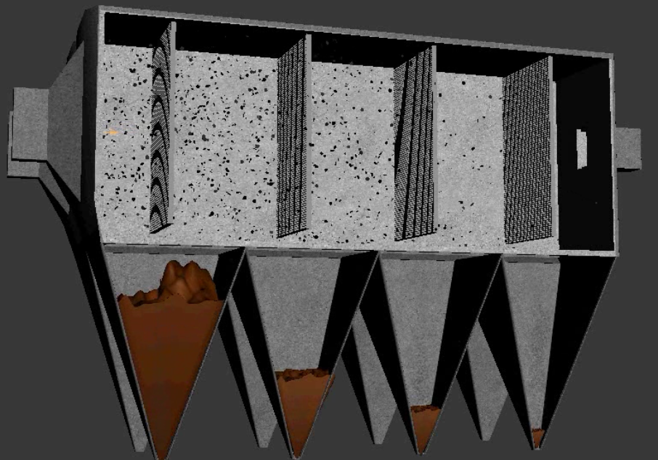
What are we trying to achieve?
Electrostatic Precipitators (ESP) having high peak voltage of 71 KV on the collecting plates to polarize the Fly-Ash (dust) Particles.
Fly-ash (dust) particles are collected in ESP Hoppers

Slide 3
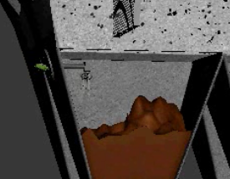
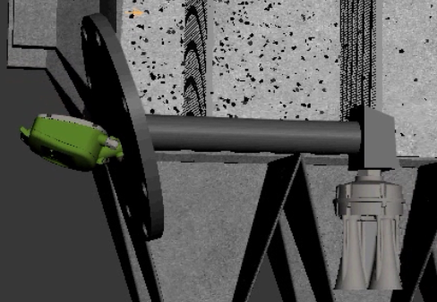

Volcan
An instrument that measures continuously the level/volume and profile of material inside the hopper

Slide 4
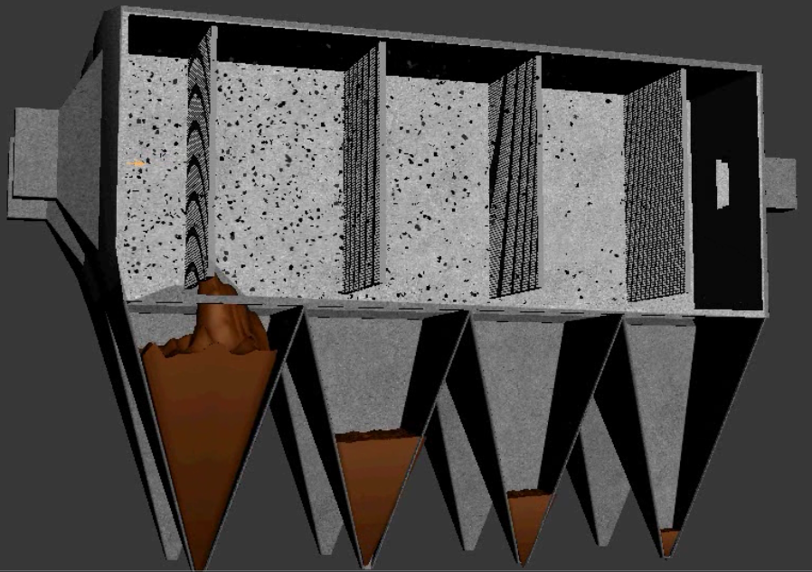
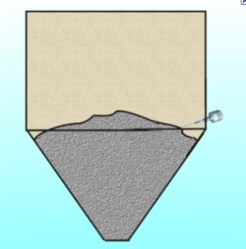
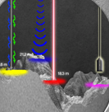
A technology challenge
Humidity
RF
Capacitance
Vibrating
Switches
Dust
High Voltage
Electro Static

Slide 5
Can we achieve the following:
Can we make the Volcan to be an integral part of the ash handling control system and therefore optimize our system?
Can emissions be reduced?
Can damage be prevented?
Can energy be saved?
Answer: Yes -> If you have a smart sensor in the hopper that knows at all times how much material is inside and how material looks like in the hopper

Slide 6
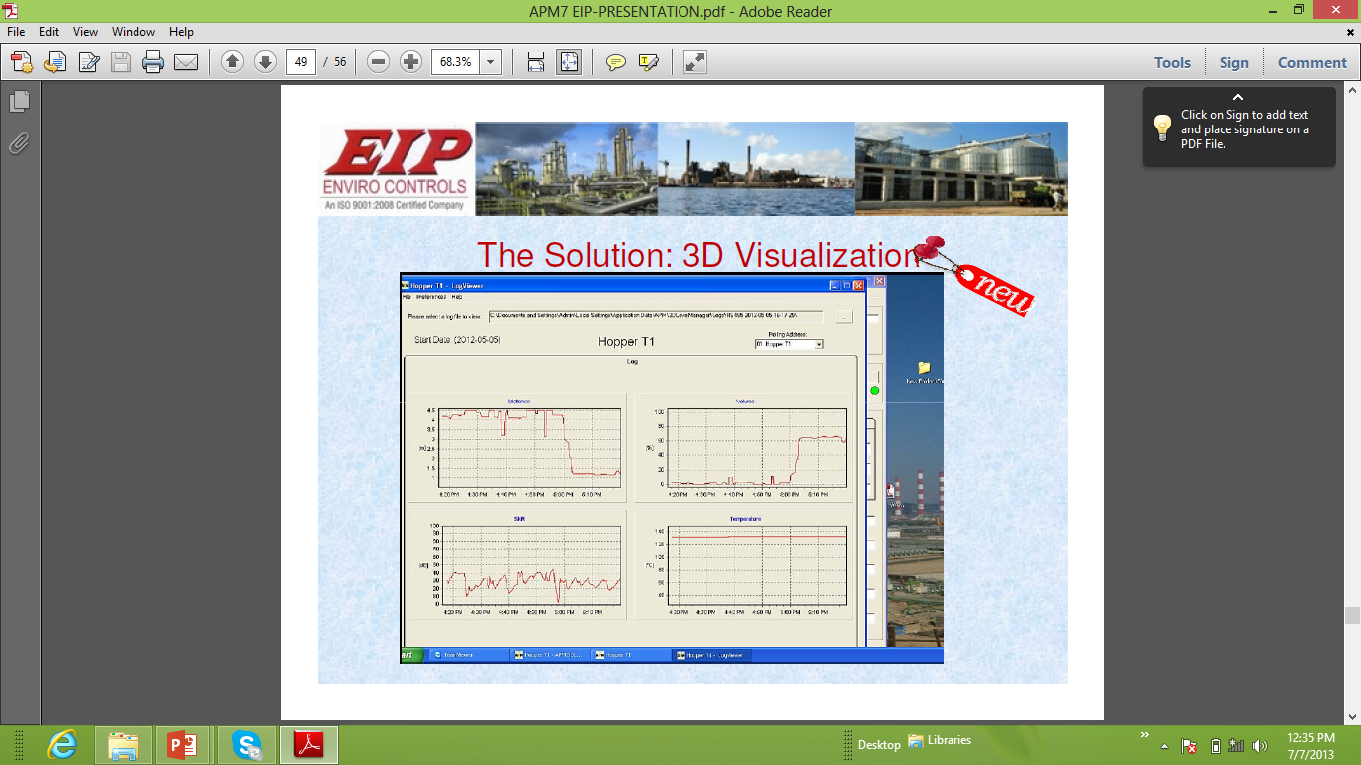
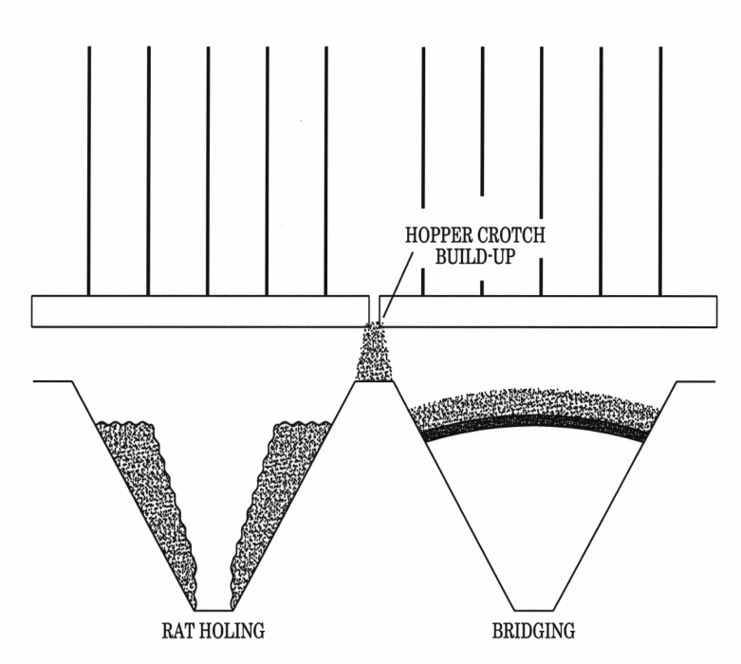
1) Can Integration help?
In the above example – the value of integration of the Volcan can be seen
  In Case of Rat Holing that are viewed in the profile on the computer – This could perhaps indicate a condensation state and the user can increase hopper heaters…
  In Case of Bridging that are profiled – The end user can call maintenance to take care and in the meantime change the voltage on the plates so as not to collect fly ash and have the fly ash collected in the following hopper

Slide 7
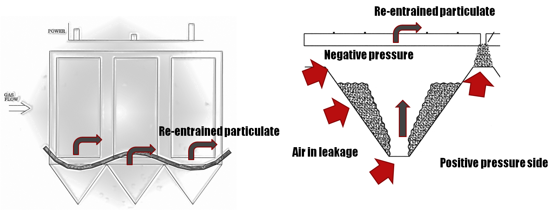
2) Can Emission be reduced?
In the above example – the value of profiling the sides of the wall can be seen
  Emission can be reduced if – as the above profile is created in the silo, it is seen, alarmed, and brought to the users awareness to handle since those situations have the tendency to increase emissions.

Slide 8
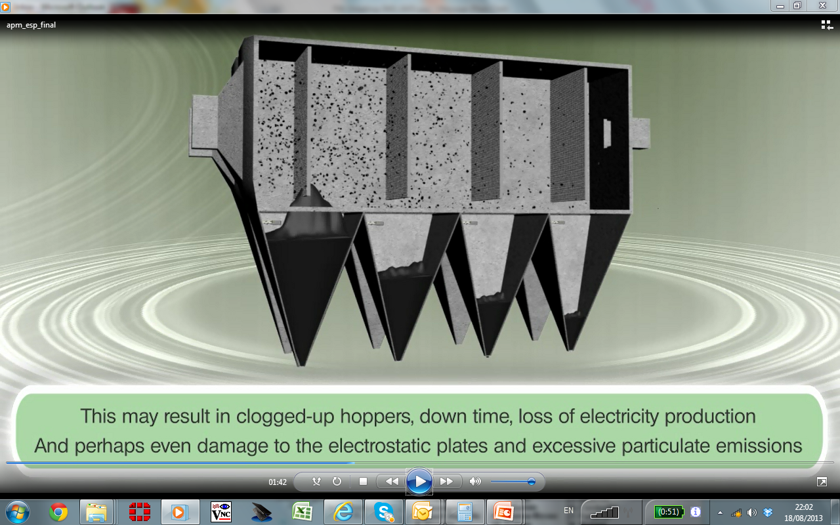
3) Can damage be reduced?
In the above example – the value of volume measurement and profiling can be seen compared with a switch
  Scenarios where the switches fail to alert the user of possible fly ash material reaching the plates with possible damage/short circuit between the collecting plate and the electrode (especially under Humid conditions),
  destroying the plate arrangement and the electrical equipment. .

Slide 9
4) Can we save Energy?
Coordinate extraction / compressor operation with hopper conditions
Minimize compressor run time by knowing whether hopper has a problem
Reduce TR power to prevent overfilling if extraction or hopper system has issues
Adjust rapping cycles in the event of ash handling problems
Check effectivity of vibrations systems
Coordinate vibration systems with extraction programs
Operations can clearly guide maintenance as to location of problem.

